Slide 1


TFS Investment Group
TFS INVESTMENT GROUP
April 2nd, 2025

Slide 2
TFS Investment Group Structure
5 industry-based coverage groups that pitch securities which are voted into the portfolio
Executives
President
CIO
COO
CMO
Consumers
Financial Institutions
Industrials
Natural Resources
Tech, Media, Telecom, Healthcare
Portfolio Manager
Portfolio Manager
Portfolio Manager
Portfolio Manager
Portfolio Manager
Senior Analyst
Senior Analyst
Senior Analyst
Senior Analyst
Senior Analyst
3 Junior Analysts
3 Junior Analysts
3 Junior Analysts
3 Junior Analysts
3 Junior Analysts
First Year Analyst
First Year Analyst
First Year Analyst
First Year Analyst
First Year Analyst
Each Coverage Group Consists of 1 Portfolio Manager, 1 Senior Analyst, 3 Junior Analysts, and 1 First Year Analyst; Coverage Groups are Responsible for Producing Multiple Pitches, Tear Sheets, and Initiation Reports over the Course of the Year at our Weekly Meetings

Slide 3




























Select Member Placements
Our members and alumni land placements in investment banking, private equity, equity research, & more
Investment Banking
Private Equity & REITS
Equity Research & Asset Management
Sales & Trading + Other Finance Roles
Sales & Trading
Placements reflect current members and alumni of TFS Investment Group

Slide 4


Contributors
TFS Investment Group – President
Experience
Achievements
University of Ottawa: Undergrad | Finance 2025
Soctiabank GBM: Equity Research Associate Intern
BMO Private Wealth: Analyst
Gold Label Marketing: Founder
TFSIG President
CIBC Stock Pitch Case Competition (2nd place)
Omnium Financier Corporate Finance (5th place)
McGill Int’l Portfolio Challenge
Joey Zahr
President
TFS
Investment
Group

Slide 5


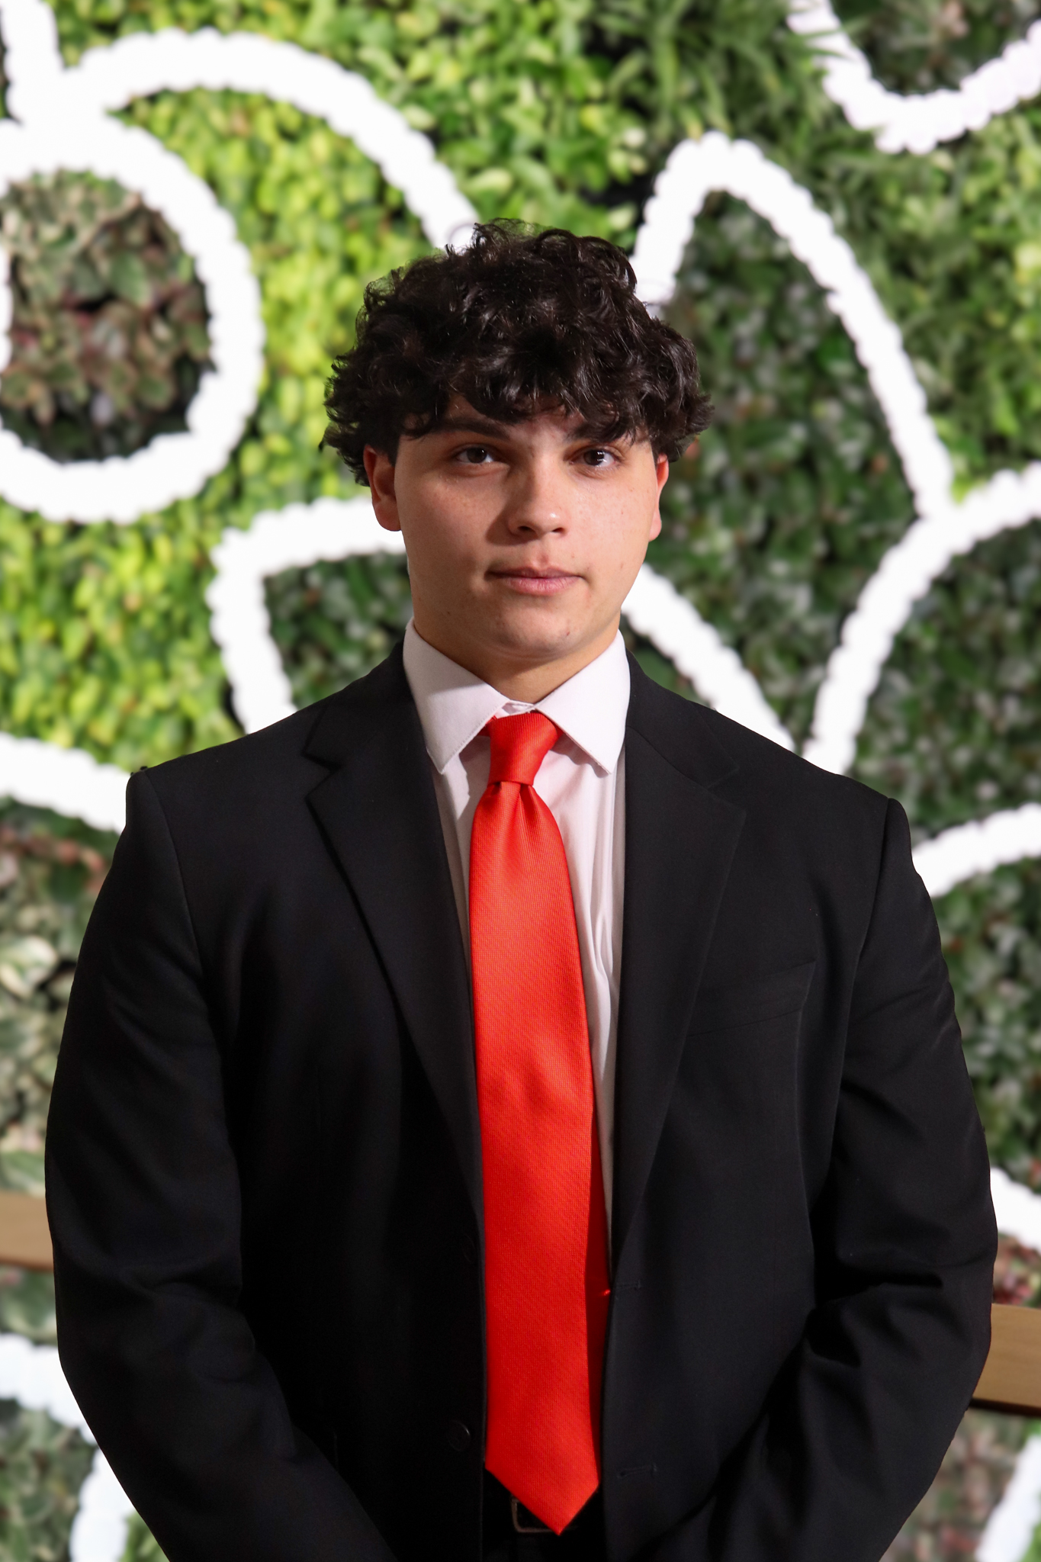
Contributors
TFS Investment Group - TMTH Team
Experience
Achievements
University of Ottawa: Undergrad | Finance 2026
TD Wealth: Equities and Derivatives Trader
TFSIG TMTH Portfolio Manager
Corey Cao
Portfolio Manager
Experience
Achievements
University of Ottawa: Undergrad | Finance 2025
IG Private Wealth: Analyst
TFSIG TMTH Senior Analyst
$TVA-B.TO restructuring, presented to Hugues Simard
$POW.TO x $GLXY.TO M&A presented to Jeffrey Orr
Analyses: https://www.thomasgiroux.work
Thomas Giroux
TMTH Senior Analyst
Experience
Achievements
University of Ottawa : Undergrad | Finance 2026tt
RBC Wealth Management: Analyst
Statistics Canada: Financial Analyst
Canada Revenue Agency: Analyst
TFSIG TMTH Junior Analyst
Omnium Financier Corporate Finance Team
McGill Int’l Portfolio Challenge – Team uOttawa
Omnium Financier Market Finance Team
Huntsman Leadership Development Summit
Carlo Abi-Raad
TMTH Junior Analyst

Slide 6



Contributors
TFS Investment Group - TMTH Team
Experience
Achievements
University of Ottawa: Undergrad | Finance 2027
Brookfield Corp: Consolidations Intern
TFSIG TMTH Junior Analyst
Chief Analyst, Telfer Asset Management League
VP Finance, Telfer Business Journal
Christian Gillam
TMTH Junior Analyst
Experience
Achievements
University of Ottawa : Undergrad | Finance 2026
Martinrea International Inc.: Financial Analyst Intern
TFSIG TMTH Junior Analyst
VP Club Development, Telfer Finance Society
Michael Penney
TMTH Junior Analyst
Experience
Achievements
University of Ottawa : Undergrad | Finance 2028tt
Sycamore Canyon Capital: Private Equity Analyst Intern
TFSIG First Year Analyst
Director Of Equity Funds, AETSA
Armaan Kumar
TMTH First Year Analyst

Slide 7
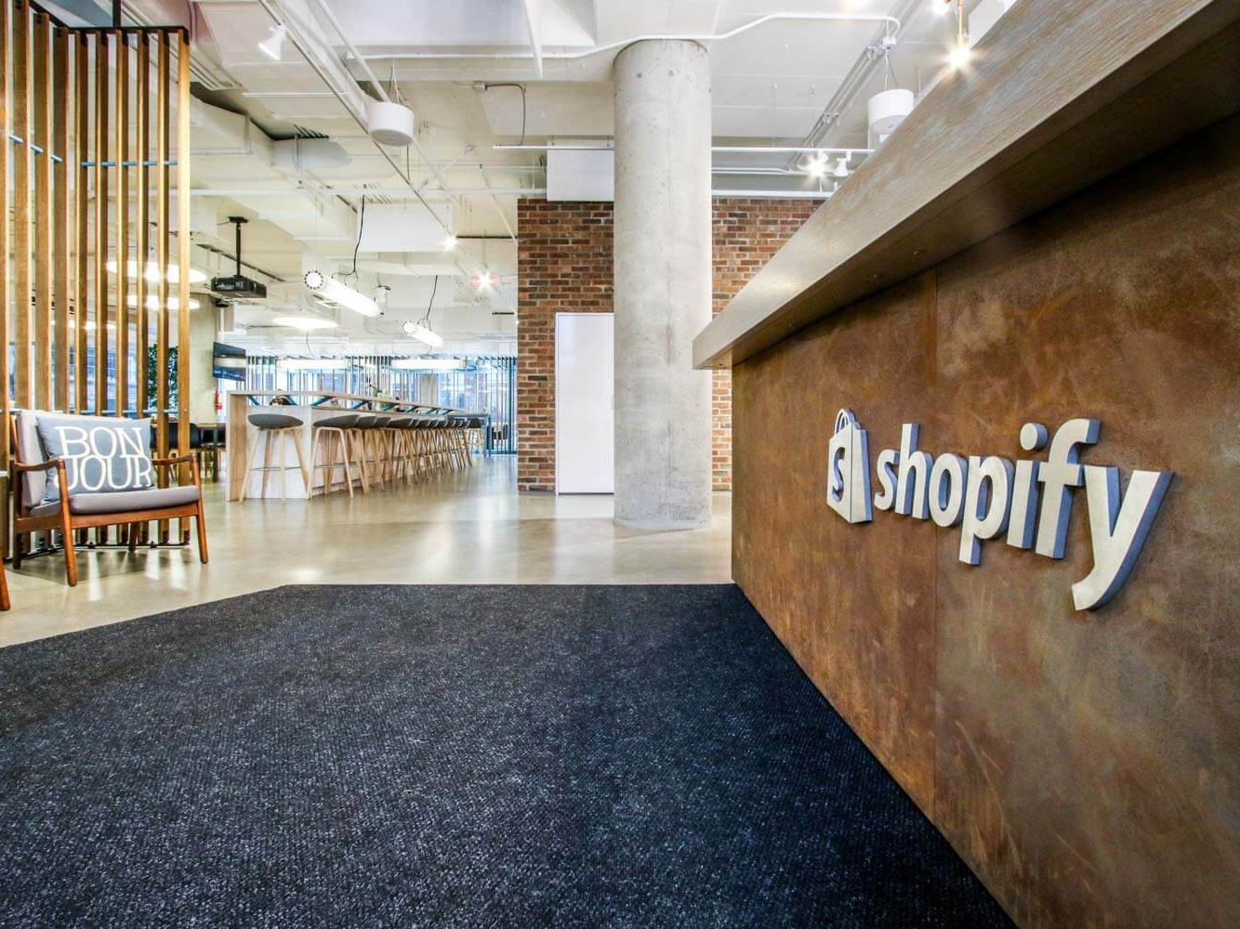
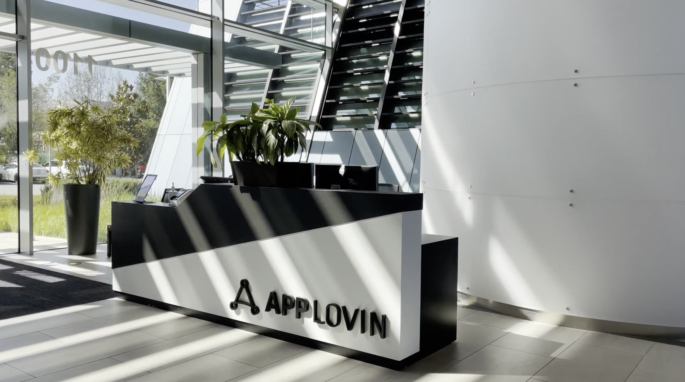


x
Merger Analysis
x

Slide 8
AppLovin Overview
Empowering Developers, Monetizing Success
Business Model
Vertical Integration
Leading growth platform helping developers acquire users, monetize apps, and optimize marketing
Software Platform – Three core solutions:
AppDiscovery – User acquisition
Adjust – Analytics & attribution
MAX – Ad mediation
AI & Cloud Tech:
AXON (AI-driven recommendations)
App Graph (data insights)
Elastic Cloud (scalability)
App Development
User Acquisition & Marketing
Analytics & Attribution
Monetization
Scalability & Infrastructure
Data Insights & Optimization (AI)
Revenue - Geographic Segments (in USD mm)
Vertical Integration

Slide 9
AppLovin Annotated Stock Chart
Key Price Movements and Trends
Source(s): Capital IQ, AppLovin

Slide 10
Muddy Waters Short Report
Addressing the Elephant in the Room
Bearish Remarks from MW
What We Make of The MW Claims
Persistent Identity Graphs (PIGs) allegedly violate user privacy via unauthorized fingerprinting
Revenue claims are overstated, MW thinks the real incremental growth is 25% instead of the 100% APP’s management claims
Advertiser (client) churn at 23% according to MW, APP management stated almost no churn
We think the MW claims in customer acquisition are false (MW claims 25% incremental revenue, we believe 70% based WF’s study)
The MW 23% advertiser churn is probable, but offset by the incremental growth and priced in our projections
MW fingerprinting and TOS violation claims are easily disproved by comparing the standard practice of Meta Google
The only serious MW threat is the TOS violation and the likely outcomes from this are elaborated below
What May Unfold Based on Past Cases
Regulatory Fines
Deplatorming
Terms of service violations from AppLovin may lead to deplatforming from Google, Meta and Apple
The retargeting + fingerprinting strategy MW claims can easily be replicated by competitors, thus eliminating differentiation
Cheetah Mobile got deplatformed by Facebook and Google (TOS violation), stock collapsed 87% thereafter
Zynga got banned from Facebook (TOS violation), stock collapsed 84% within a year
Criteo got fined (40 millions euros) by French Gov for violating data protection laws ~2.30% of sales for that year (‘23)
Facebook $5bn fine in ‘19 for Cambridge Analytica (7.07% of ‘19 sales)
Google fined 1.5bn euros by EU in ‘19 for abusive ad tactics (1% of sales for ‘19)
Source(s): Capital IQ, PitchBook, Bloomberg, Factiva

Slide 11
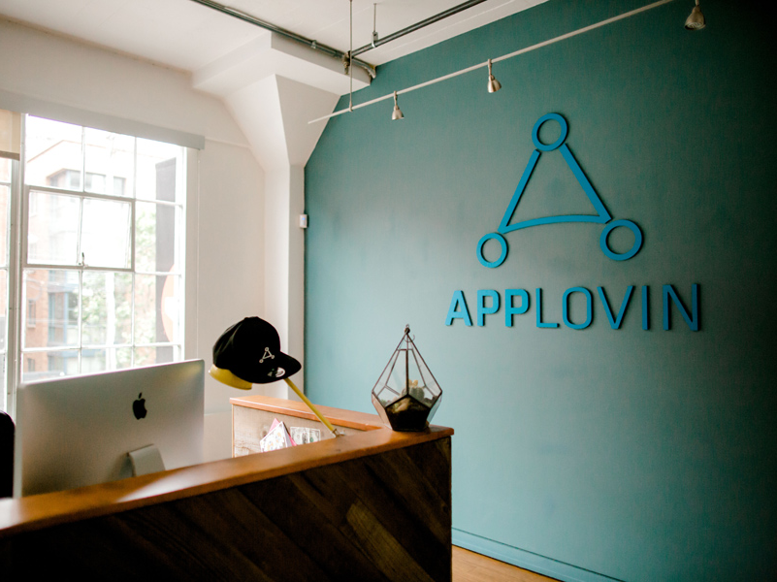
Key Statements Analysis

Slide 12
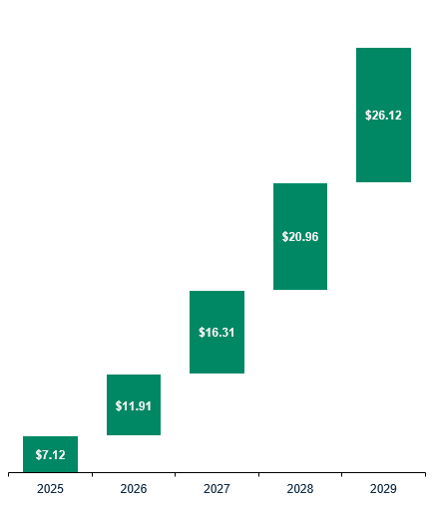
Projected EBITDA and EPS
Accelerating Profitability: Projected EBITDA & EPS Growth Outlook
Projected EBITDA (in USD mm)
Projected Earnings Per Share

Slide 13
Projected Net Income
Strong Forecasted Growth
Drivers
Expansion of platform and product offerings
Increased demand for mobile advertising
Strategic acquisitions and partnerships

Slide 14
Balance Sheet
3 Statement Model – Assets, Liabilities, and Equity Highlights
Assets
=
Liabilities
+
Equity

Slide 15
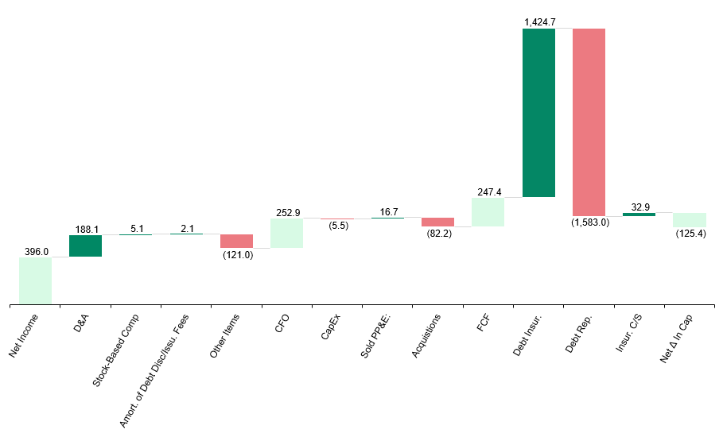
Cash Flow Statement
3 Statement Model – Cash Flow 2025E Highlights (in USD mm)

Slide 16
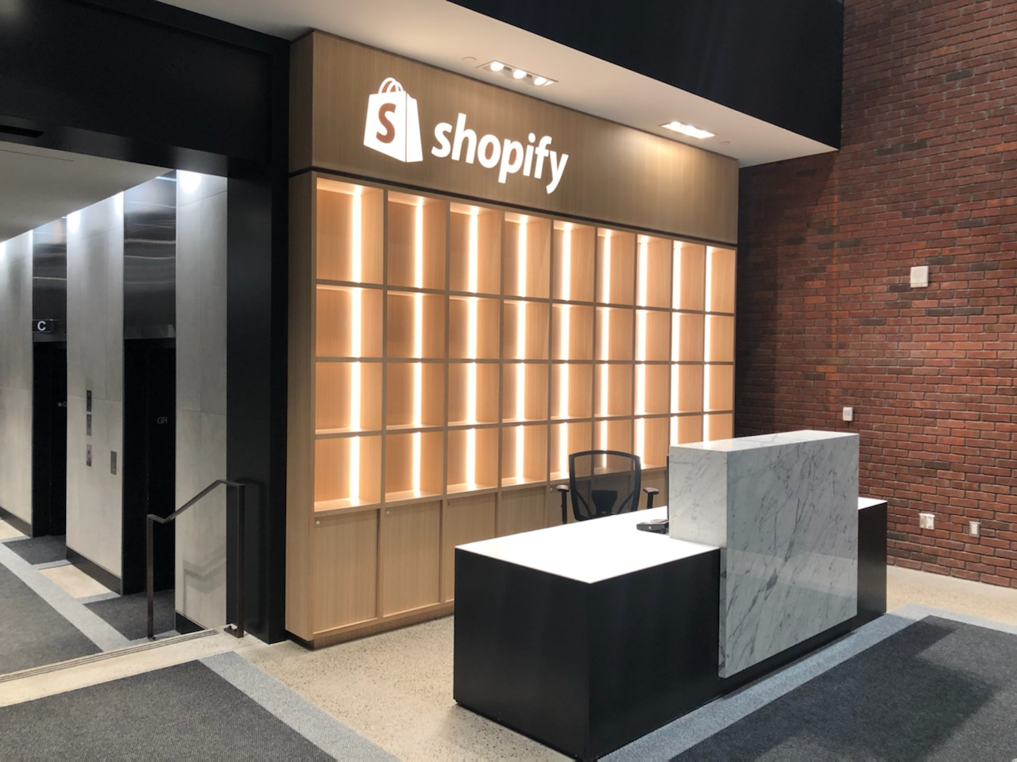
DCF Analysis

Slide 17
WACC Inputs
Key Assumptions and Drivers
4.32%
Risk-Free Rate
2.31
Beta
4.33%
Equity Risk Premium
27.98%
Tax Rate
3.54%
Cost of Debt

Slide 18
DCF - Revenue Projection
Projecting Top-Line Performance

Slide 19
DCF - COGS Projections
Analyzing Cost Efficiency and Profitability
COGS and COGS as a Percentage of Revenue
(USD mm)

Slide 20
DCF FCFF Projections
Assessing Cash Flow Sustainability
Projected Free Cash Flow to Firm
(USD mm)

Slide 21
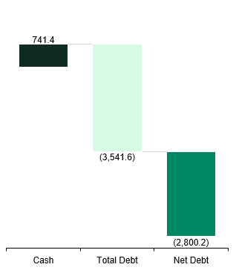
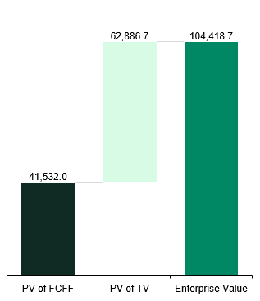
DCF Target Price
Derived Via Forward EV/Revenue Multiples
Enterprise Value
Adjustments to Equity Value
Equity Value
(USD mm)
(USD mm)
($ per share)
+
$295.51

Slide 22

Synergies

Slide 23
Acquisition Rationale and Synergies
Why Shopify May Want To Acquire AppLovin
Acquisition Rationale
1.4B
DAU’s
Massive user base, increasing SHOP’s ad market
Growing
TAM
Boost customer acquisition and monetization
Diversification of SHOP’s LT growth
4.23% Mobile Games CAGR
Synergies
Revenue
Headcount Reduction
Axon Improvement
Axon AI will directly increase the reach of merchants’ ad spend
APP planned to skim its headcount, but with SHOP’s higher margins, layoffs are irrefutable
Real-time data from Shopify’s merchants would continuously improve the model

Slide 24
Revenue Synergies
Axon AI Engine Will Expand Merchants’ TAM
Axon’s Powerful ROI on Ad Spend
Synergistic Merchant Sales (USD bn)
15.15% CAGR
Source: Wedbush 02/’25 ER on APP, SEC 10Ks/10Qs

Slide 25
Cost Synergies
OpEx Consolidation and Gradual Reductions
(10%) APP Headcount, Per Year for Next 10 Years
(10%) of APP’s R&D, Per Year for Next 10 Years (in USD mm)

Slide 26
Synergies Snapshot
Impactful Bottom-Line Results From The M&A
Shopify and AppLovin’s Respective EPS Forecasts
EPS Accretion Justifies the M&A

Slide 27
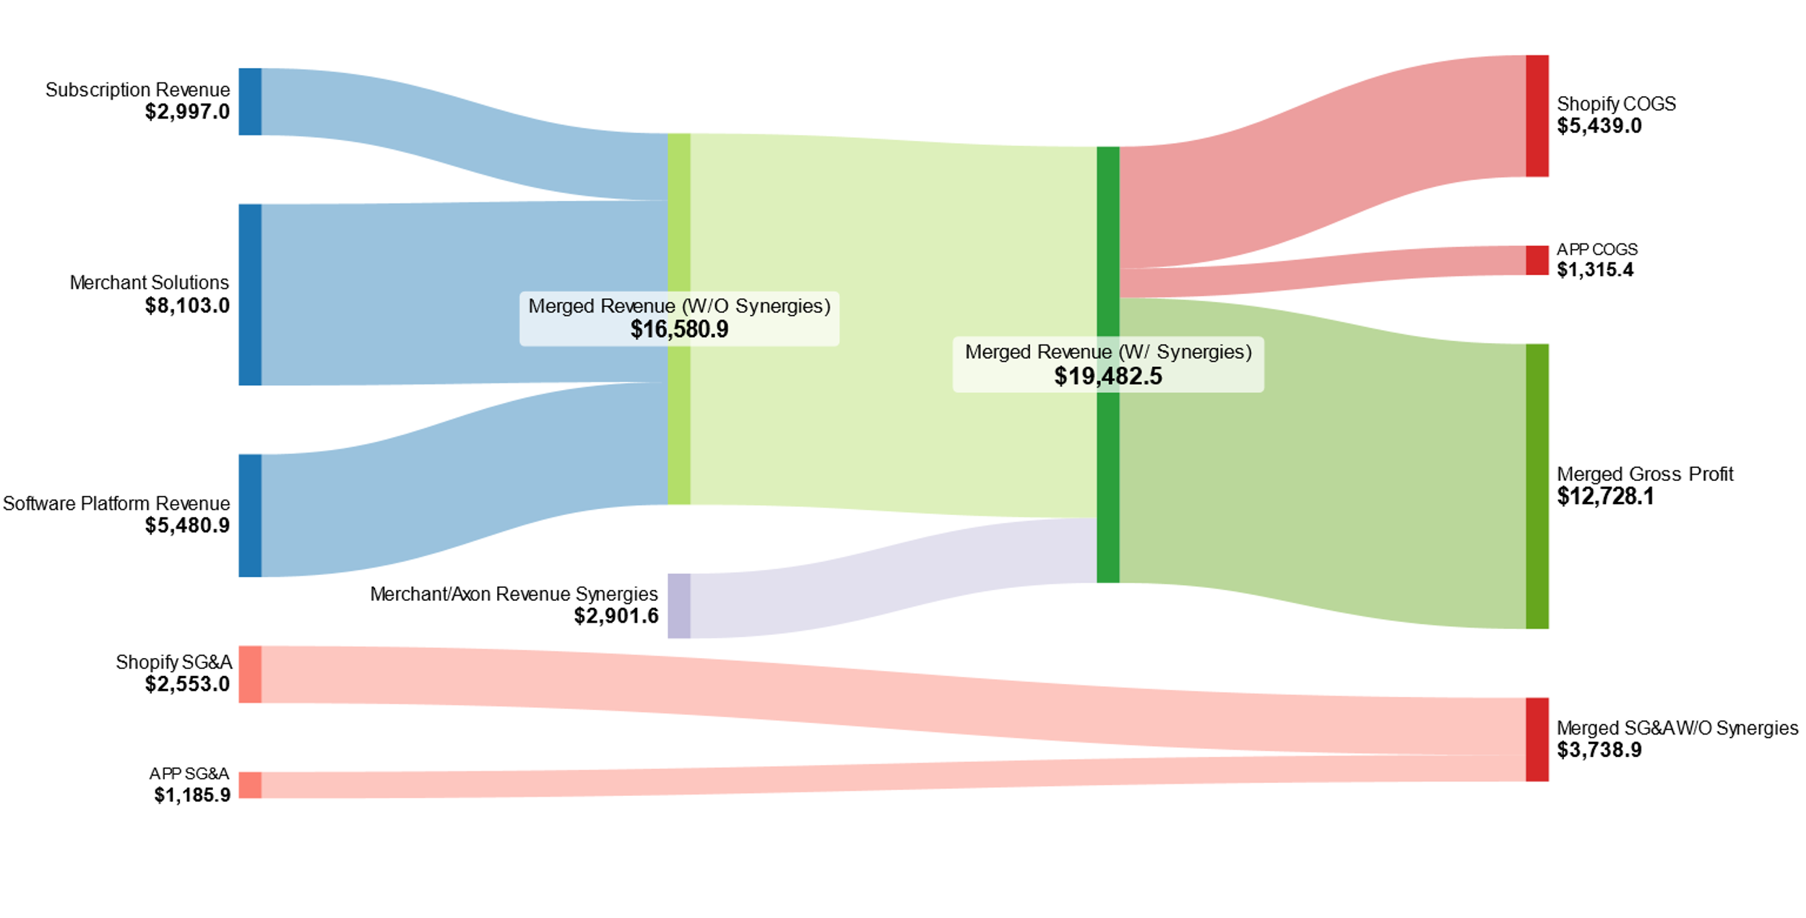
Merged Income Flow (in USD mm)
Visualizing the Synergized Income Flow of AppLovin & Shopify

Slide 28

Value Creation Strategy

Slide 29
SWOT Analysis Shopify
Strategies, Weaknesses, Opportunities, Threats
Strengths
Weaknesses
Scalability & Flexibility
High Competition
Brand Recognition & Customer Trust
Rising Operations Costs
Global Reach
Customer Acquisition Costs
Opportunities
Threats
Growth in BNPL & Fintech
Macroeconomic uncertainty
AI & Automation
Regulatory & Data Privacy Risks
Expansion into Emerging Markets
Fluctuation in Payment Processing Revenue

Slide 30
SWOT Analysis APP
Strategies, Weaknesses, Opportunities, Threats
Strengths
Weaknesses
Strong Market Position
Regulatory and Privacy Risks
Software Revenue Growth
Competition with Large Tech
High Retention of Clients
High R&D
Opportunities
Threats
Growth in Mobile Ad Spending
Economic Downturn
Expansion into non-gaming Sectors
Regulatory Challenge
Increased AI Integration
Regulatory Challenge

Slide 31
Strategic Product Offerings
Increased Software Industry Exposure
Expanding Reach Through Ads & New Products
Ad Industry Domination
New Product Offerings
Integrate AppLovin software into the categories of "start" and "market" on the website to optimize tools for a wider population
Expanding into a 213.91-Billion-dollar industry that Shopify had not touched on previously by offering these new products for developers and business owners

Slide 32


Strategic Synergies Between Shopify and AppLovin
From Carts to Charts: Scaling with Smart Synergies
Shopify AI tools enable: Automated product copywriting AI-powered customer chat Sales and inventory forecasting | Advanced AI and Data Analytics | Axon AI engine enables: Real-time ad targeting User behavior modeling Bidding optimization
Shopify Audiences enables: Smarter ad targeting on social platforms Enhanced performance in search advertising | Enhanced Advertising & User Acquisition | AppDiscovery and MAX provide: High-performance ad monetization Global reach across 1.4B+ devices
Shopify’s Commerce structure enables: Omnichannel commerce infrastructure is built for SMBs to enterprises | Cross-Platform Expansion | Operates a global network of: Mobile apps Mobile games Ideal distribution channel for in-app commerce

Slide 33
Delivering Tangible Benefits to End-Users
More Reach. More Revenue. More Reasons to Use Shopify.
App Developers
Adding Shopify storefronts or affiliate links inside app/games
Easier access to e-commerce APIs
Expanded audience reach
Access to Shopify’s payments, fulfillment, and analytics stack
Shopify Merchants
Improved ad performance
New ad monetization tools
One-stop commerce and marketing
Better customer intelligence
Feature / Benefit | Shopify Today | After AppLovin
Programmatic Ad Reach
In-App Commerce Integration
Smart Ad Targeting (AI) | Limited | Advanced
Developer Ecosystem Access | Moderate | Expanded

Slide 34
5 Year Timeline Plan
What the Next 5-Years Will Look Like For Shopify
Phase | Year 1 | Year 2 | Year 3 | Year 4 | Year 5
Analysis
Integration
Cultural Fit Assessment
Revenue/Cost Synergies Analysis
On-Going Adjustments
Preparation and Planning
Sales and Marketing Integration
Tech and Ad Platform Integration
Post-Merger Monitoring and Adjustments

Slide 35

Scenario Analysis

Slide 36
Likelihood that Management Accepts an M&A
Founders Have Gradually Decreased Their Stake
Takeaway
3 Founders’ Collective Ownership (shares in million)
According to an NLP + tonality analysis of the past 8 transcripts, the management team is increasingly showing openness to a deal
All three founders’ ownership in APP has decreased by 31.4% since Q2 ‘21
As of the latest earnings’ tonality, our likelihood score for openness towards a deal is 90%
BlackRock and Vanguard have absorbed insiders’ stake, which suggests an easier acquisition of shares on the open market
NLP Shows Positive Tonality Towards a Deal
Quarter | Statement Section Sentiment | Q&A Response Section Sentiment | Adjusted Tonality Score (0-10) | Adjusted Likelihood (%) | Comment and Revised Justification
Q1 2023 | Neutral-Positive | Neutral-Negative | 5.50 | 55% | Mixed signals; openness balanced by cautious responses
Q2 2023 | Positive | Neutral-Positive | 7.00 | 70% | Strong positive sentiment in initial statements
Q3 2023 | Positive | Positive | 8.00 | 80% | Uniform positivity across sections
Q4 2023 | Neutral-Positive | Neutral | 6.50 | 65% | Moderate positivity tempered by neutral Q&A response
Q1 2024 | Positive | Positive | 8.00 | 80% | Strong management positivity and openness
Q2 2024 | Positive | Positive | 8.50 | 85% | Explicitly positive sentiment in strategic discussions
Q3 2024 | Positive | Positive-Neutral | 8.00 | 80% | Continued strategic positivity with slight caution
Q4 2024 | Highly Positive | Neutral-Positive | 9.00 | 90% | Strategic realignment shows clear openness
Source(s): Capital IQ, PitchBook, Bloomberg

Slide 37
Ownership
Founders’ Individual Ownership (# of shares) + Major Holders
Adam Foroughi (shares in mm)
Major Holders
Holder | Type of Holder | Common Shares (mm) | % of Out.
Adam Foroughi | Co-Founder, CEO | 36.2 | 10.3%
BlackRock | Institutional Investor | 20.3 | 5.8%
Ling Tang | Individual | 17.2 | 4.9%
Vanguard | Institutional Investor | 16.6 | 4.7%
Andrew Karam | Co-Founder, VP | 13.1 | 3.7%
FMR | Institutional Investor | 13.1 | 3.7%
Tang Hao | Individual Investor | 12.0 | 3.4%
John Krystynak | Co-Founder, VP | 11.2 | 3.2%
GQG | Institutional Investor | 8.4 | 2.4%
Eduardo Vivas | Individual Investor | 7.6 | 2.2%
Andrew Karam (shares in mm)
John Krystynak (shares in mm)
Source(s): Capital IQ, Nasdaq, Bloomberg

Slide 38









Shopify Ventures Portfolio
Where AppLovin Could Also Fit in the Equation
Future Of Commerce
Developer + Infrastructure
Supports innovative commerce solutions and entrepreneurs globally
Shopify
Ventures
Source(s): Capital IQ, PitchBook, Bloomberg

Slide 39
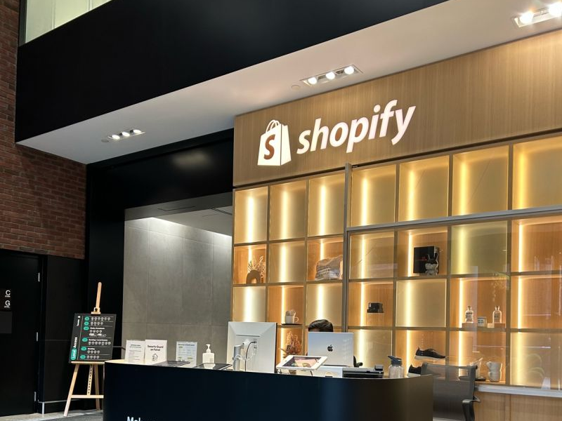
M&A Financing

Slide 40
Purchasing Scenario
If SHOP Were to Pursue the Deal (in USD mm)
+
106,495.3
51%
54,312.6
APP EV @ DCF
Controlling Stake
+
20%
65,175.1
54,312.6
Control + Synergy Premium
Purchase Price
Sensitivity Analysis – Purchase Price (Control Premium/Implied Share Price)
65175 | 12% | 14% | 16% | 18% | 20% | 22% | 24% | 26% | 28%
275 | 56719 | 57732 | 58745 | 59757 | 60770 | 61783 | 62796 | 63809 | 64822
280 | 57721 | 58752 | 59782 | 60813 | 61844 | 62875 | 63905 | 64936 | 65967
285 | 58723 | 59772 | 60820 | 61869 | 62918 | 63966 | 65015 | 66063 | 67112
290 | 59725 | 60792 | 61858 | 62925 | 63991 | 65058 | 66124 | 67191 | 68257
295 | 60727 | 61811 | 62896 | 63980 | 65065 | 66149 | 67234 | 68318 | 69402
300 | 61729 | 62831 | 63934 | 65036 | 66138 | 67241 | 68343 | 69445 | 70548
305 | 62731 | 63851 | 64971 | 66092 | 67212 | 68332 | 69452 | 70572 | 71693
310 | 63733 | 64871 | 66009 | 67147 | 68285 | 69424 | 70562 | 71700 | 72838
315 | 64735 | 65891 | 67047 | 68203 | 69359 | 70515 | 71671 | 72827 | 73983

Slide 41
Net Present Value of Acquisition
PV of Cost & Revenue Synergies Y1 - Y10
1.30x
2,308.54
21,168.1
PV of Cost Synergies (including multiplier)
Cost Synergy Multiplier
PV of Revenue Synergies
Control Premium & Total (USD bn)
$ 23,476.64
$10,862.52
$12,614.12
PV of all Synergies
Premium Paid
NPV of Deal

Slide 42
M&A Financing
Optimizing Excess Cash, Debt and Equity
Shopify’s Excess Cash
Maximum Debt Raising
usd mm | 2024A
Cash and Equivalents | 1,498.0
Marketable Securities | 3,981.0
Total Cash | 5,479.0
Minimum Cash (Daily) | 81.3
Buffer (IB fees) | 200
Excess Cash w/ 2-month buffer | 5,204
usd mm | 2024A
EBIT | 1,075.0
Target ICR | 5.0x
Interest Rate Assumption | 6.00%
Maximum Allowable Interest Expense | 215.0
Maximum Debt | 3,583.3
Sensitivity Analysis - Max Debt (Interest Rate on Debt/Maximum Interest Expense)
 | 5.00% | 5.25% | 5.50% | 5.75% | 6.00% | 6.25% | 6.50% | 6.75% | 7.00%
265 | 5300 | 5048 | 4818 | 4609 | 4417 | 4240 | 4077 | 3926 | 3786
253 | 5050 | 4810 | 4591 | 4391 | 4208 | 4040 | 3885 | 3741 | 3607
240 | 4800 | 4571 | 4364 | 4174 | 4000 | 3840 | 3692 | 3556 | 3429
228 | 4550 | 4333 | 4136 | 3957 | 3792 | 3640 | 3500 | 3370 | 3250
215 | 4300 | 4095 | 3909 | 3739 | 3583 | 3440 | 3308 | 3185 | 3071
203 | 4050 | 3857 | 3682 | 3522 | 3375 | 3240 | 3115 | 3000 | 2893
190 | 3800 | 3619 | 3455 | 3304 | 3167 | 3040 | 2923 | 2815 | 2714
178 | 3550 | 3381 | 3227 | 3087 | 2958 | 2840 | 2731 | 2630 | 2536
165 | 3300 | 3143 | 3000 | 2870 | 2750 | 2640 | 2538 | 2444 | 2357
Source(s): Capital IQ, PitchBook, Bloomberg

Slide 43
Deal Financing
Full Merger Financing (DCF Price), usd millions
DCF Financing Breakdown
Equity Share Exchange Ratio – April 1, ‘25
65,175
APP 20 Day VWAP $294.86
SHOP share price $97.64
SER: 3.02x
What SHOP is paying + equity issuance fee ($1.1b)
$295.51 + 20% = $354.61
5,204
Excess cash with buffer less
IB/legal fees ($200m)
3,583
Maximum debt + issuance fees
51% of APP Shares Outstanding: 179m
SER: 3.02x
540.4m Shares Issued at 97.64$ per share
56,388
Stock issuance
Source(s): Capital IQ, PitchBook, Bloomberg

Slide 44
Risks In This Deal
Risks to Transaction Success
Risk Matrix
Types of Risk | Key Risk
Transaction Execution Risk | Regulatory Issues, FTC may block the deal Target’s Rejection, APP May Reject Offer Lack Of Capital, SHOP may fail to raise adequate capital for the acquisition Proxy Battle, potential for a proxy battle with current APP shareholders
Integration & Strategic Risks | E. Key Players Leave: Key executives and talent may leave F. Synergies May Not Materialize: SHOP fails to realize synergies from APP
Governance & Control Risks | G. Refinance APP’s Debt: May need to refinance APP’s debt, which could be costly or difficult in current market conditions
A
E
F
C
Impact
B
G
D
Possibility
Mitigation Feasibility
Easy
Medium
Hard

Slide 45
Risks In This Deal
Mitigation Strategy (Ranked From Easiest To Mitigate)
Risks
Mitigants
A
Compliance with Data Privacy Laws, Engage Early with Regulatory Authorities, Complete Proper Due Dilligence
B
Secure Support from Key Shareholders, Reducing Execution and Regulatory Risks, Address Employee and Cultural Concerns
C
Issuing New Shares onto the Market, Structure a Deal with Minimum Cash Upfront, Explore Government/Institutional Support
D
Engage with Shareholders Early and Proactively, Negotiate to find Common Ground
E
Identify and Prioritize Key Talent, Offer Financial and Career Incentives, Create a Positive Integration Experience
F
Develop a Clear and Executable Integration Plan, Leverage Tech and AI Integration
G
Refinance Debt Using SHOP’s Stronger Balance Sheet to Decrease Interest Expenses

Slide 46

Relative Valuation

Slide 47








Company Debt To Equity Ratio
Similar Companies to AppLovin
Company |  | D/E
 |  | 2.33%
 |  | 1.05%
 |  | 3.51%
 |  | 1.23%
 |  | 4.17%
 |  | 0.65%
 |  | 0.14%
 |  | 1.79%
 |  | 3.29%
RV
Comp Set
Companies Not Included
In Comp Set
Average D/E Ratio: 1.86%
High
D/E Ratio
Source(s): Pitchbook, Capital IQ

Slide 48











Precedent Transactions Analysis
Tech M&A with Similar Purchase Prices
Acquirer |  | Target | Value (USD, bn) | Premium Paid
 |  |  | 68.7 | 45%
 |  |  | 28 | 31%
 |  |  | 61 | 32%
 |  |  | 35 | 35%
 |  |  | 27.7 | 55%
 |  |  | 60.8 | 20%
Average Premium: 39.6%
Source(s): Pitchbook, Capital IQ

Slide 49
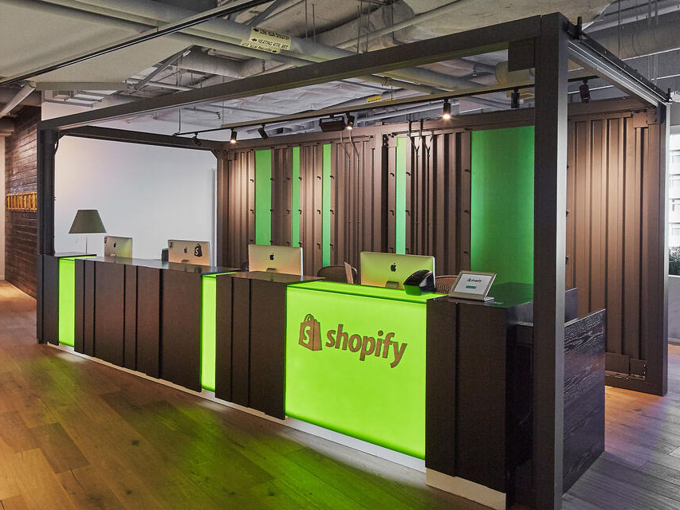
Appendix

Slide 50
DCF - Key Assumptions
Underlying Inputs and Forecast Rationale
Assumptions
Key Metrics | Historical Average (5yr) | Projected Average (10yr) | Projected Average (5yr)
Revenue | 38.96% | 21.61% | 28.91%
COGS | 34.96% | 23.15% | 23.30%
Gross Margin | 65.04% | 77.95% | 79.41%
SG&A | 38.03% | 16.41% | 17.23%
EBITDA Margin | 24.66% | 60.30% | 60.54%
EBIT Margin | 8.88% | 55.67% | 54.78%
CapEX | 0.15% | 0.12% | 0.14%
Tax Rate | 7.14% | 27.98% | 27.98%
D&A | 1.13% | 0.78% | 0.92%
NWC | 0.49% | 0.37% | 0.53%
Assumptions
Key Metrics |  |  | Value
Terminal Growth Rate |  |  | 4.00%
US GDP LT Growth Rate (1948-2024) |  |  | 3.20%
TV WACC |  |  | 13.19%
EV/EBITDA Multiple |  |  | 14.9x
Terminal Year EBITDA |  |  | 17,144.26
Dilluted Shares Outstanding |  |  | 343.84

Slide 51
WACC Calculation
Unlocking Intrinsic Value
Capital Structure Weights
Costs of Capital
WACC
X
13.92%

Slide 52
WACC Calculation (for TV)
Long-Term Value Creation
Capital Structure Weights
Costs of Capital
TV WACC
X
13.19%

Slide 53
10 Year TV/EV Calculation
Assumptions
10-Year Terminal Value
Key Metrics | Value
Terminal Growth Rate | 4.00%
US GDP LT Growth Rate (1948-2024) | 3.20%
TV WACC | 13.19%
EV/EBITDA Multiple | 14.9x
EV/Revenue Multiple | 6.7x
Terminal Year EBITDA | 17,144.26
Terminal Year Revenue | 32,369.97
Diluted Shares Outstanding | 343.87
Perpetual Growth Rate Method |  |  | 4.00%
Growth Rate |  |  | 4.00%
US GDP LT Growth Rate |  |  | 3.20%
TV WACC |  |  | 13.19%
5yr FCFF * (1+g) |  |  | 13,155.99
Terminal Value |  |  | 143,232.16
PV of Terminal Value |  |  | 41,531.96
% of EV |  |  | 51.34%
PV of FCFF |  |  | 39,356.58
% of EV |  |  | 48.66%
Enterprise Value |  |  | 80,888.55
10-Year Terminal Value
10-Year Terminal Value
EBITDA Exit Multiple Method |  |  | 14.9x
EV/EBITDA Multiple |  |  | 14.90
Terminal Year EBITDA |  |  | 17,144.26
Terminal Value |  |  | 255,449.54
PV of Terminal Value |  |  | 74,070.80
% of EV |  |  | 65.30%
PV of FCFF |  |  | 39,356.58
% of EV |  |  | 34.70%
Enterprise Value |  |  | 113,427.39
Revenue Exit Multiple Method |  |  | 6.7x
EV/Revenue Multiple |  |  | 6.70
Terminal Year Revenue |  |  | 32,369.97
Terminal Value |  |  | 216,878.79
PV of Terminal Value |  |  | 62,886.73
% of EV |  |  | 60.23%
PV of FCFF |  |  | 41,531.96
% of EV |  |  | 39.77%
Enterprise Value |  |  | 104,418.69

Slide 54
Comparable Company Overview
Comparable Companies With Market data, Financials, and Benchmarking Relative To Peers
Main Country Of Operation: US
Market Capitalization: 31,618.8
NTM Revenue: 3,003.63 M
NTM EBITDA: 639.13 M
(15% Weight RV)
Main Country Of Operation: US
Market Capitalization: 27,934.7 M
NTM Revenue: 2,892.31 M
NTM EBITDA: 1,131.44 M
(35% Weight RV)
Main Country Of Operation: US
Market Capitalization: 1,510,694.3 M
NTM Revenue: 188,514.29 M
NTM EBITDA: 113,004.94 M
(25% Weight RV)
Main Country Of Operation: US
Market Capitalization: 2,011,461 M
NTM Revenue: 389,845.03 M
NTM EBITDA: 172,903.44 M
(20% Weight RV)
Main Country Of Operation: France
Market Capitalization: 2,004.2 M
NTM Revenue: 1,178.43 M
NTM EBITDA: 393.73 M
(5% Weight RV)
Source(s): Pitchbook, Capital IQ

Slide 55
Comparable Company Overview
Similar Companies to AppLovin
Logos | Company Name | Ticker | Overview
 | HubSpot, Inc. | NYSE:HUBS | HubSpot provides a cloud-based marketing, sales, and customer service software platform referred to as the growth platform. The applications are available ala carte or packaged together. HubSpot's mission is to help companies grow better and has expanded from its initial focus on inbound marketing to embrace marketing, sales, and service more broadly
 | The Trade Desk, Inc | NasdaqGM:TTD | The Trade Desk provides a self-service platform that helps advertisers and ad agencies programmatically find and purchase digital ad inventory (display, video, audio, and social) on different devices like computers, smartphones, and connected TVs. It utilizes data in an iterative manner to optimize the performance of ad impressions purchased.
 | Meta Platforms, Inc. | NasdaqGS:META | Meta is the largest social media company in the world, boasting close to 4 billion monthly active users worldwide. The firm's "Family of Apps," its core business, consists of Facebook, Instagram, Messenger, and WhatsApp. Meta packages customer data, gleaned from its application ecosystem and sells ads to digital advertisers.
 | Alphabet Inc. | NasdaqGS:GOOGL | Alphabet is a holding company that wholly owns internet giant Google. The California-based company derives slightly less than 90% of its revenue from Google services, the vast majority of which is advertising sales. Alongside online ads, Google services houses sales stemming from Google's subscription services and devices.
 | Criteo S.A. | NasdaqGS:CRTO | Criteo SA is an ad-tech company in the digital advertising market. Its technology, allows retailer advertisers to launch multichannel and cross-device marketing campaigns in real time. With real-time return on investment analysis of the ads, the firm's clients can adjust their marketing strategies dynamically. It has two reportable segments: Retail Media and Performance Media.
Source(s): Pitchbook, Capital IQ

Slide 56



Relative Valuation
Important Relative Valuation Ratios
14.9x
$$\text{N}\text{TM}→\frac{\text{EV}}{\text{EBITDA}}$$
× 25% Weight
$ 141.14
Implied Price
22.0x
$$\text{NTM}→\frac{\text{EV}}{\text{Revenue}}$$
× 40% Weight
$ 100.71
Implied Price
$$\text{NTM}→\frac{\text{Price}}{\text{Earnings}}$$
6.70x
× 35% Weight
$ 180.69
Implied Price
Total Implied Share Price: $ 138.81
(Suggesting a downside of 46%)
Source(s): Pitchbook, Capital IQ

Slide 57










Precedent Transaction Analysis
Similar Transactions Comparable to SHOP X APP
Deal Date | Investors (Acquirer) | Acquired Companies | EV/Revenue | EV/EBITDA
01-Sep-2021 |  |  | 3.2x | 9.9x
30-Apr-2021 |  |  | 2.8x | 35.7x
21-Oct-2024 |  |  | 3.3x | 16.1x
10-Jun-2021 |  |  | 1.7x | 25.1x
14-Jan-2020 |  |  | 1.9x | 12.4x
Max |  |  |  | 3.3x | 35.7x
Median |  |  |  | 2.8x | 16.1x
Min |  |  |  | 1.7x | 9.9x
Average |  |  |  | 2.6x | 19.9x
Source(s): Pitchbook, Capital IQ

Slide 58
Precedent Transactions
Important Precedent Transactions Ratios
EV/EBITDA
EV/Revenue
16.1x
2.8x
(30% Weight In PTA)
(70% Weight In PTA)
We prioritized EV/Revenue over EV/EBITDA to better capture enterprise value due to AppLovin being an earlier stage company and more consistent Revenue
Source(s): Pitchbook, Capital IQ

Slide 59
Precedent Transactions
Summary: Precedent Transactions And Final Enterprise Value From PTA
Precedent Transactions
(Target Prices)
Precedent Transactions Weights
(As a Percentage)
Precedent Transactions
(Final Consolidated EV)
X
$ 20,460.41M
Total Implied Enterprise Value: $20,460.41 M
(Suggesting a downside of 80.93%, ~ $51.94 Implied Share Price)
Source(s): Pitchbook, Capital IQ

Slide 60



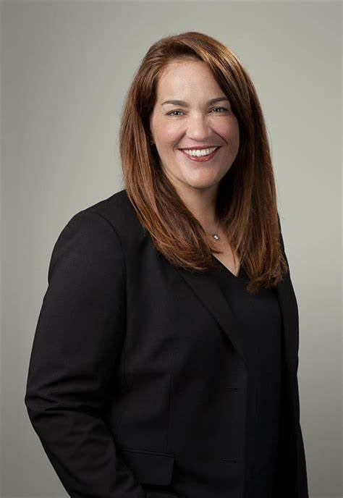
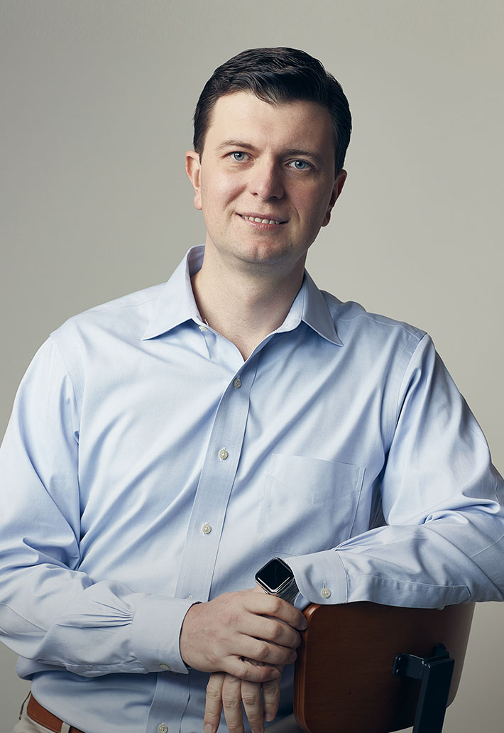
Management Overview
Who are the Leaders of This Company
Vice-President of Engineering
Chief Legal Officer and Corporate Secretary
CEO and Co-Founder
Chief Financial Officer
Chief Technology Officer
Adam Foroughi
Giovanni Ge
Matt Stumpf
Victoria Valenzuela
Basil Shiken
He began his career as a derivatives trader. Adam founded two companies: Lifestreet Media and Social Hour; where he applied and expanded his knowledge of mobile technology. In 2018, Adam received the Ernst & Young Entrepreneur of the Year Award
Giovanni led research in machine learning at Meta, BlackRock and Uber. He has a PhD, Condensed Matter and Materials Physics from the Scuola Internazionale Superiore di Studi Avanzati and completed his undergraduate at the University of Science and Technology of China
Matt worked at PWC providing financial consulting on M&A transactions in the tech industry. He began his career in financial audit at PWC and is a Certified Public Accountant. He holds a B.A. in Business Management Economics from the University of California, Santa Cruz
Victoria was General Counsel and Vice President, Legal Affairs, and Corporate Secretary at Cypress Semiconductor, as well as an M&A and Securities Attorney with Clifford Chance US and Brobeck, Phleger & Harrison LLP. Tory holds a law degree from Stanford University
Basil was one of AppLovin’s early hires and previously served as Vice President of Engineering. Before joining AppLovin, Basil was a Senior Software Engineer at DeviceAnywhere

